Slide 1
Cloud Core MBA
Architecture Design Session
Notes:
Icebreakers on this slide:
Stand up/Sit down
Introduce your colleague
After each table finishes introducing each other, then introduce the ADS Challenge team.

Slide 2
Purpose
To experience the Azure value proposition the way most customer’s do: by creating a solution in Azure, going from requirements to design to working solution without getting overly technical.

Slide 3
Abstract
In this workshop, you will participate in an Architecture Design Session (ADS), so you get to experience the key steps in the design process. You will then review an implementation of one possible solution to the customer requirements presented in the ADS, providing you with hands-on knowledge of how Azure delivers value to customers.

Slide 4
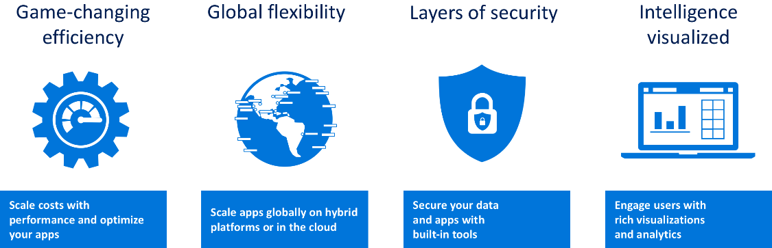
Understanding the Azure value proposition
Notes:
Complete set of integrated cloud offerings, from IaaS to PaaS to SaaS.
Unmatched global scale (54 regions available in 140 countries)
Built-in security + comprehensive compliance certifications
Analytics and built-in intelligence

Slide 5
Why Microsoft Azure?
If we define a value proposition as the benefits a customer gains from your products and services then…
The Azure value proposition is that it enables organization to remain focused on delivering on their value proposition.
Notes:
Removal of infrastructure management
Cost savings through smaller IT footprint
Integration with Office 365, Microsoft Dynamics 365, Power Platform
Comprehensive analytics capabilities allow companies to better understand their customers and how they are using their applications
Easy to quickly enhance applications by chaining Azure services and using serverless technologies

Slide 6
Architecture Design Session

Slide 7


What is an ADS?
An Architecture Design Session (ADS) is a one- to multi-day engagement driven by technical sales that maps technical solutions to customer opportunities.
Notes:
Before we discuss mastery of an Architecture Design Session, let’s first define what an ADS is.
[Read definition on slide.]
There are alternatives to the collaborative problem-solving approach of an ADS – before committing to an ADS you should be sure an ADS is the best engagement option.
A product briefing or demonstration is better for information on Microsoft services and offerings.
Hands-on labs or trainings are better for providing experience with our services.
How any of you have participted an ADS before?
That’s what this session is about: helping each other navigate to success in delivering an ADS.

Slide 8

Your ADS experiences
How often do you deliver an ADS?
How do you prepare for an ADS?
How much information do you typically have when you walk into and ADS session?
How do you know if an ADS has been successful?
Notes:
Discussion questions

Slide 9
The goal for the customer, is to get a solution designed and deployed. Increasing Azure consumption is the Microsoft goal. The ADS supports both goals, either via a pilot or direct production implementation, or through projects that de-risk critical aspects along the way.
What are the
ADS outcomes?
Notes:
Your ADS may involve delivering technical artifacts in addition to documentation and a detailed plan. Building a pilot that runs in your customer’s Azure subscription is most likely your goal. Sometimes you need to proof-out to de-risk certain aspects of the design by creating a POC. There are some benefits to doing this:
Builds confidence
Creates trust
Ensures successful pilot
As a technical seller, you'll tend to prefer pilots because they get the meter going in the customer's subscription. However, does not diminish the value of proofs of technology, as they may be created en route to the pilot.
A proof of technology is meant to overcome customer objections by demonstrating the solution will solve the problem for which it is designed. Treat a PoT as a continuous learning and improvement process for the solution. A rapid execution tempo of the PoT helps validate the customer’s requirements, while giving them confidence in your ability to deliver on your promises. A successful PoT can serve as evidence that your practice can use for future engagements with your customer or new ones. In fact, many times the output of a PoT can be added to your practice’s intellectual property list for demonstrations, or used to accelerate future solutions.

Slide 10
Example ADS activities including pre & post work
Before the ADS
Preliminary requirements clarification | 9:00 am - 9:30 am
Ideation & Baseline/Candidate Architecture Discussion | 9:30 am - 10:30 am
During the ADS
 | Day 1
Detailed discovery | 9:00 am - 12:00 pm
Envisioning | 1:00 pm - 5:00 pm
 | Day 2
Whiteboard Candidate Architecture(s) | 9:00 am - 12:00 pm
Identify and define POC and Pilot(s) | 1:00 pm – 4:00 pm
Document high level deliverables and next action steps | 4:00 pm – 5:00 pm
This work can be performed remotely.
After the ADS
Create architecture diagrams | *Varies by project
Review architecture diagrams with ADS team | 9:30 am - 10:30 am
This work can be performed remotely.
The ADS should be performed in-person.

Slide 11
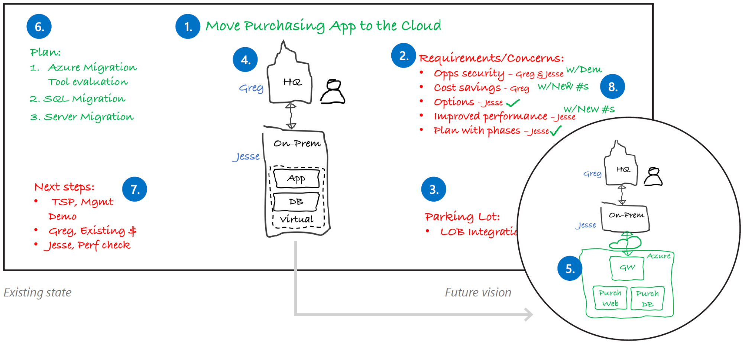
Proven practice whiteboard layout
Project Goal
Plan
Requirements
Future State
Next Steps
Current State
Parking Lot
Notes:
Whiteboards and Surface Hub support the type of collaboration you’ll need for a successful ADS.
Focus on your stakeholders, use the whiteboard as a tool for recording ideas, and get approval at each step before moving forward.
1. Project goal
Write down the project goal to help focus everyone to the desired outcomes.
2. Requirements and concerns
Begin with the items you’ve listed from the pre-call. Make sure that everyone gets a chance to be heard. Write down names next to each person’s requirements or concerns.
3. Parking lot
Acknowledge out-of-scope items. Help people set these concerns aside for later and focus back on the topic at hand.
4. Current state
Diagram the current state and ownership in black. The customer may help diagram this on the whiteboard. Be careful with technical depth. Focus on the system details that affect the ADS outcomes.
5. Future vision
Capture a high-level view of what the customer really wants in green before diving into technologies. Help customers envision the potential opportunities with Microsoft technologies.
6. Implementation plan
Break the plan into clear steps so the customer can track the project schedule and budget flexibility.
7. Next steps
Assign immediate action items during the meeting.
8. Wrap-up
Verify with all stakeholders that their requirements and concerns have been sufficiently addressed with the solution and plan. Close with agreement on the next steps.

Slide 12
Contoso Sports League Association

Slide 13

Customer situation
Contoso Sports League Association is one of the worlds largest sports franchises
They run a highly successful e-commerce website
Have back-end website to support call center
Need to maintain PCI DSS Level 1 compliance
Notes:
e-commerce website sells merchandise to their legions of sports fans.
built using ASP.NET
Currently hosted in a co-lo.
They also have a backend website that supports their call center. Call center employees use this admin website to view customer orders.
They accept payment by credit card, and owing to their high annual volume (in the tens of millions, processing about 50K per day) of transactions, need to ensure that they are PCI DSS Level 1 compliant.
Their website hosts the shopping cart and checkout process
They defer the credit card authorization and capture responsibilities of the credit card processing to a third-party payment gateway.
This payment gateway provides a web API that is invoked over TLS from Contoso server side logic.
The call includes the credit card holder data (name, number, etc.) and returns a status indicating a success or failure in authorizing and capturing payment against the credit card.

Slide 14
Customer needs
Migrate existing solution into PaaS services
Ensure data privacy and protection
Provide better management of usernames and passwords
Add failover capabilities
Enhance application functionality with serverless cloud services

Slide 15
Customer objections
Can we provide a solution that scales to meet our public demand, but is also secure for use by our call center and backend services?
What options are available for performance monitoring?
How can Azure Trust Center help with PCI compliance?
Is it possible to automatically failover the database without having to update connection settings in our applications?
Can we conduct audits and penetration testing against an Azure data center?

